Slide 1
2021/05/11 GFP Cooling System Test Update
Jiancheng Zeng
Northeastern University

Slide 2
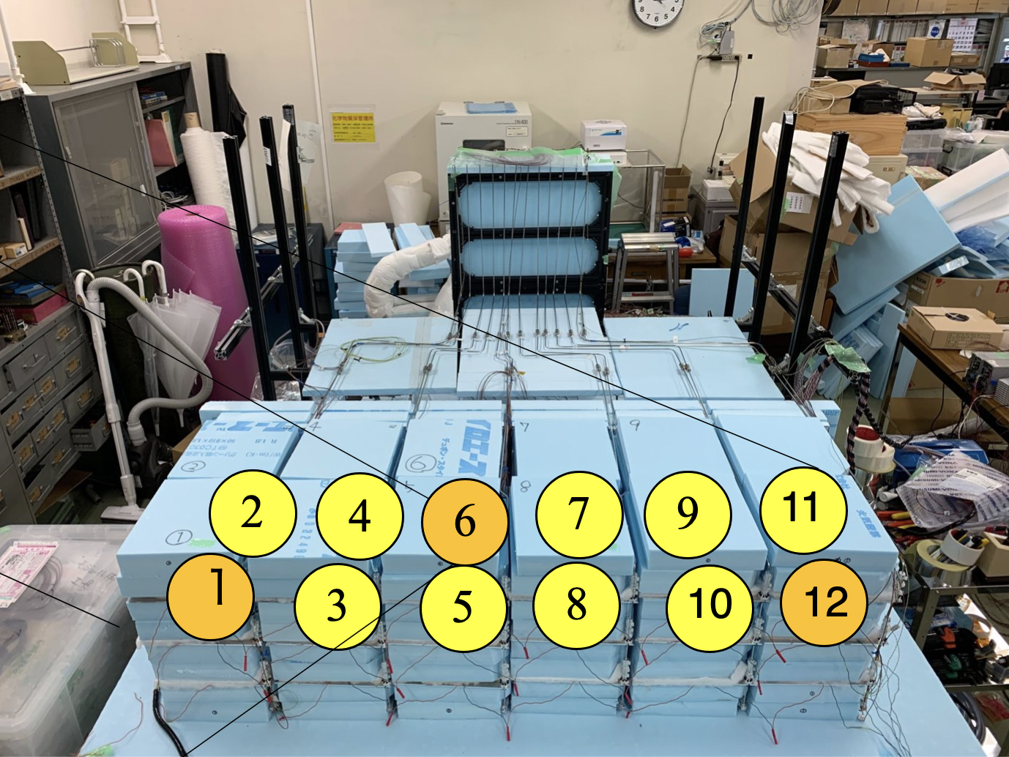

Slide 3
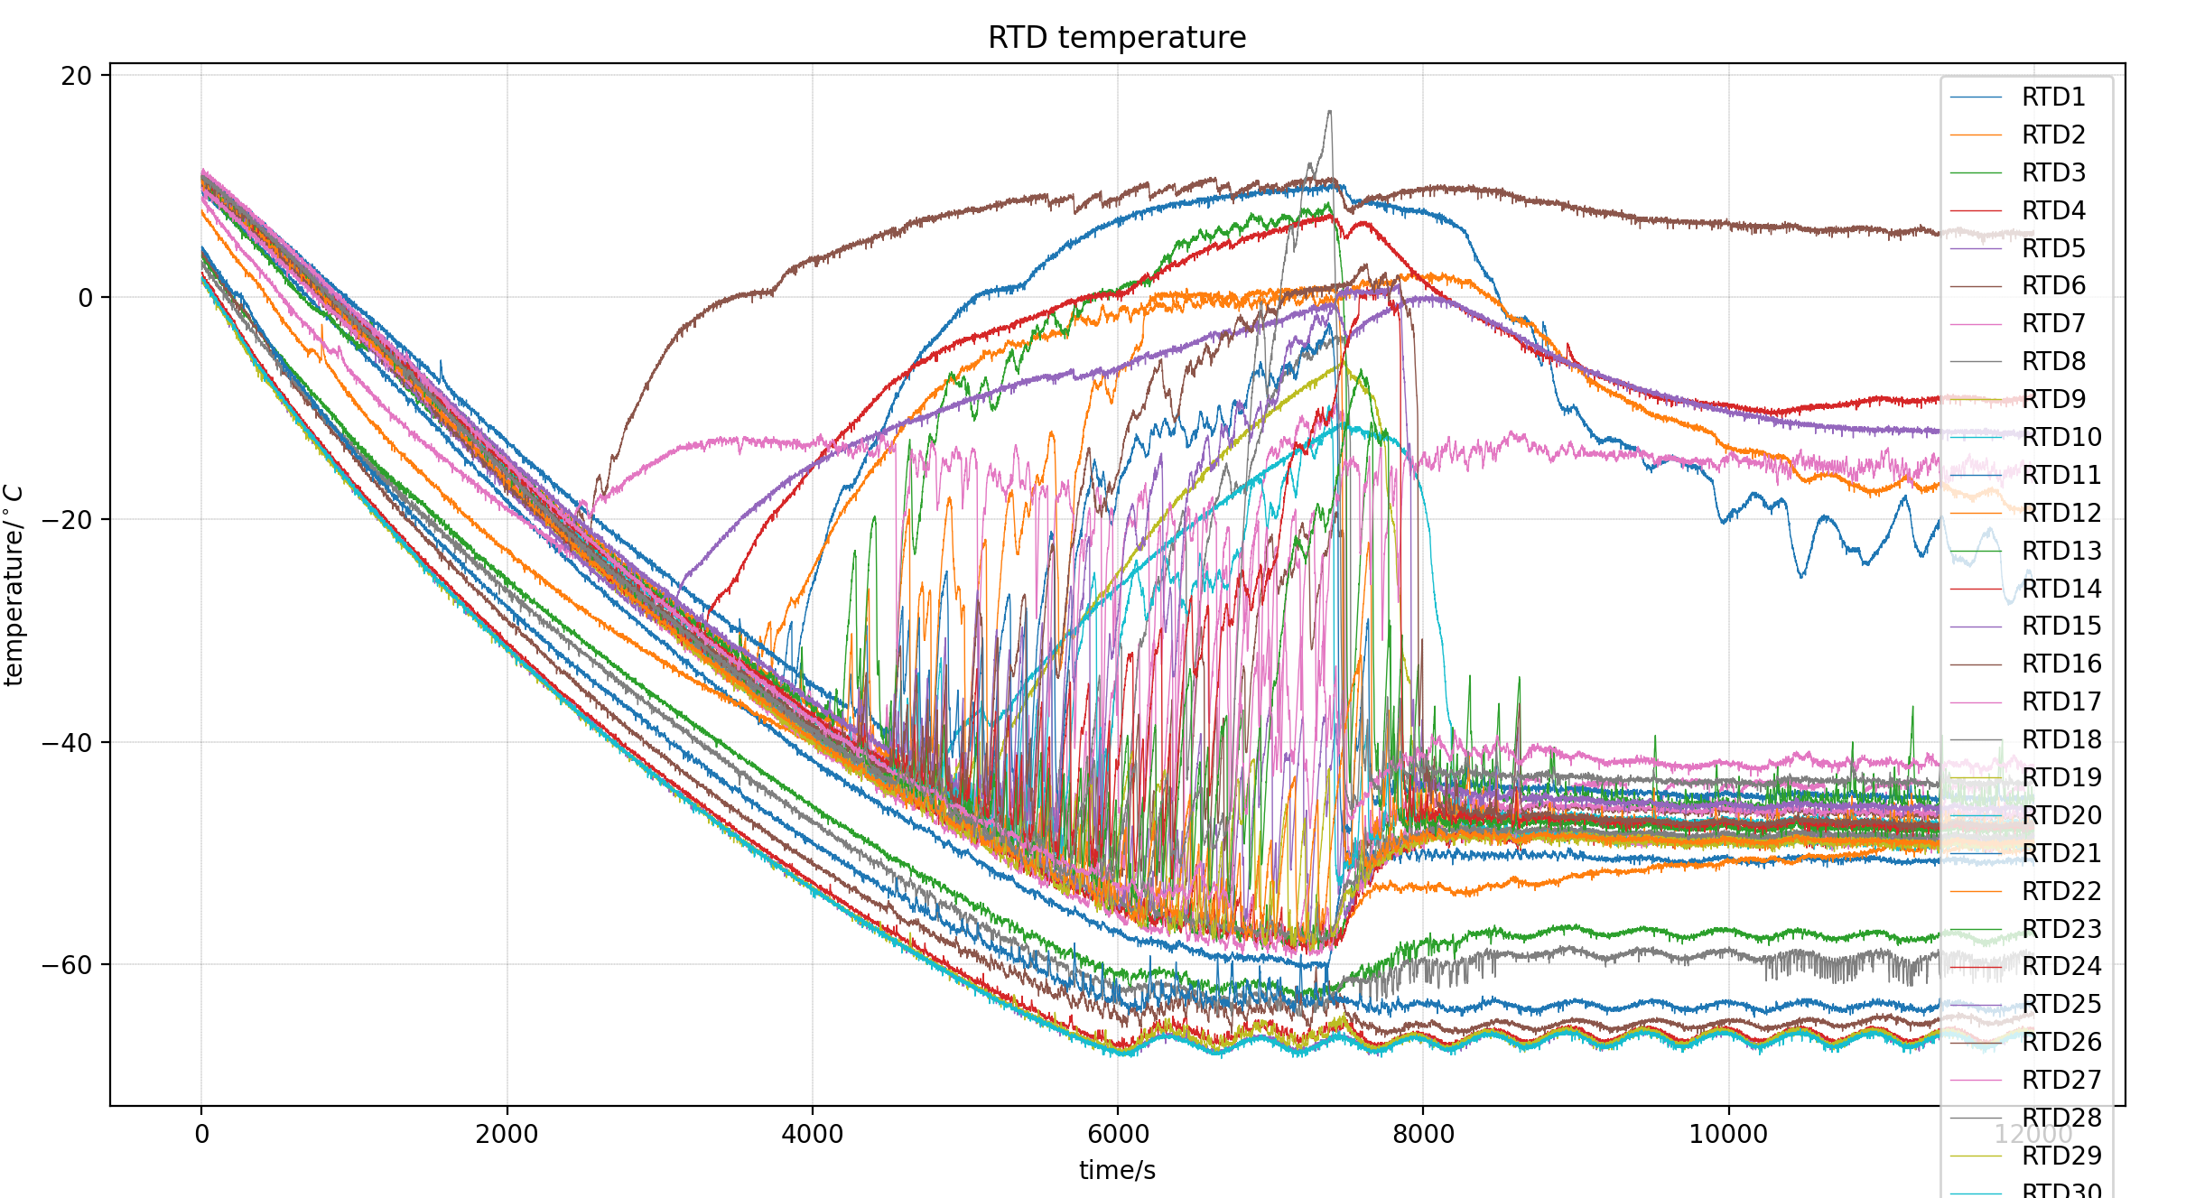
First testing general results
In general it takes 2 hours to let radiator and reservoir cool down to -70 degree C.
Here I didn’t include the warmup process, with chiller circulation pump working, it takes 3-4 hrs to come back to room temperature. With natural process it takes over 24 hrs to get back to room temperature
Chiller temperature is set to be -70 degree C, radiator temperatures are around -65 degree C

Slide 4
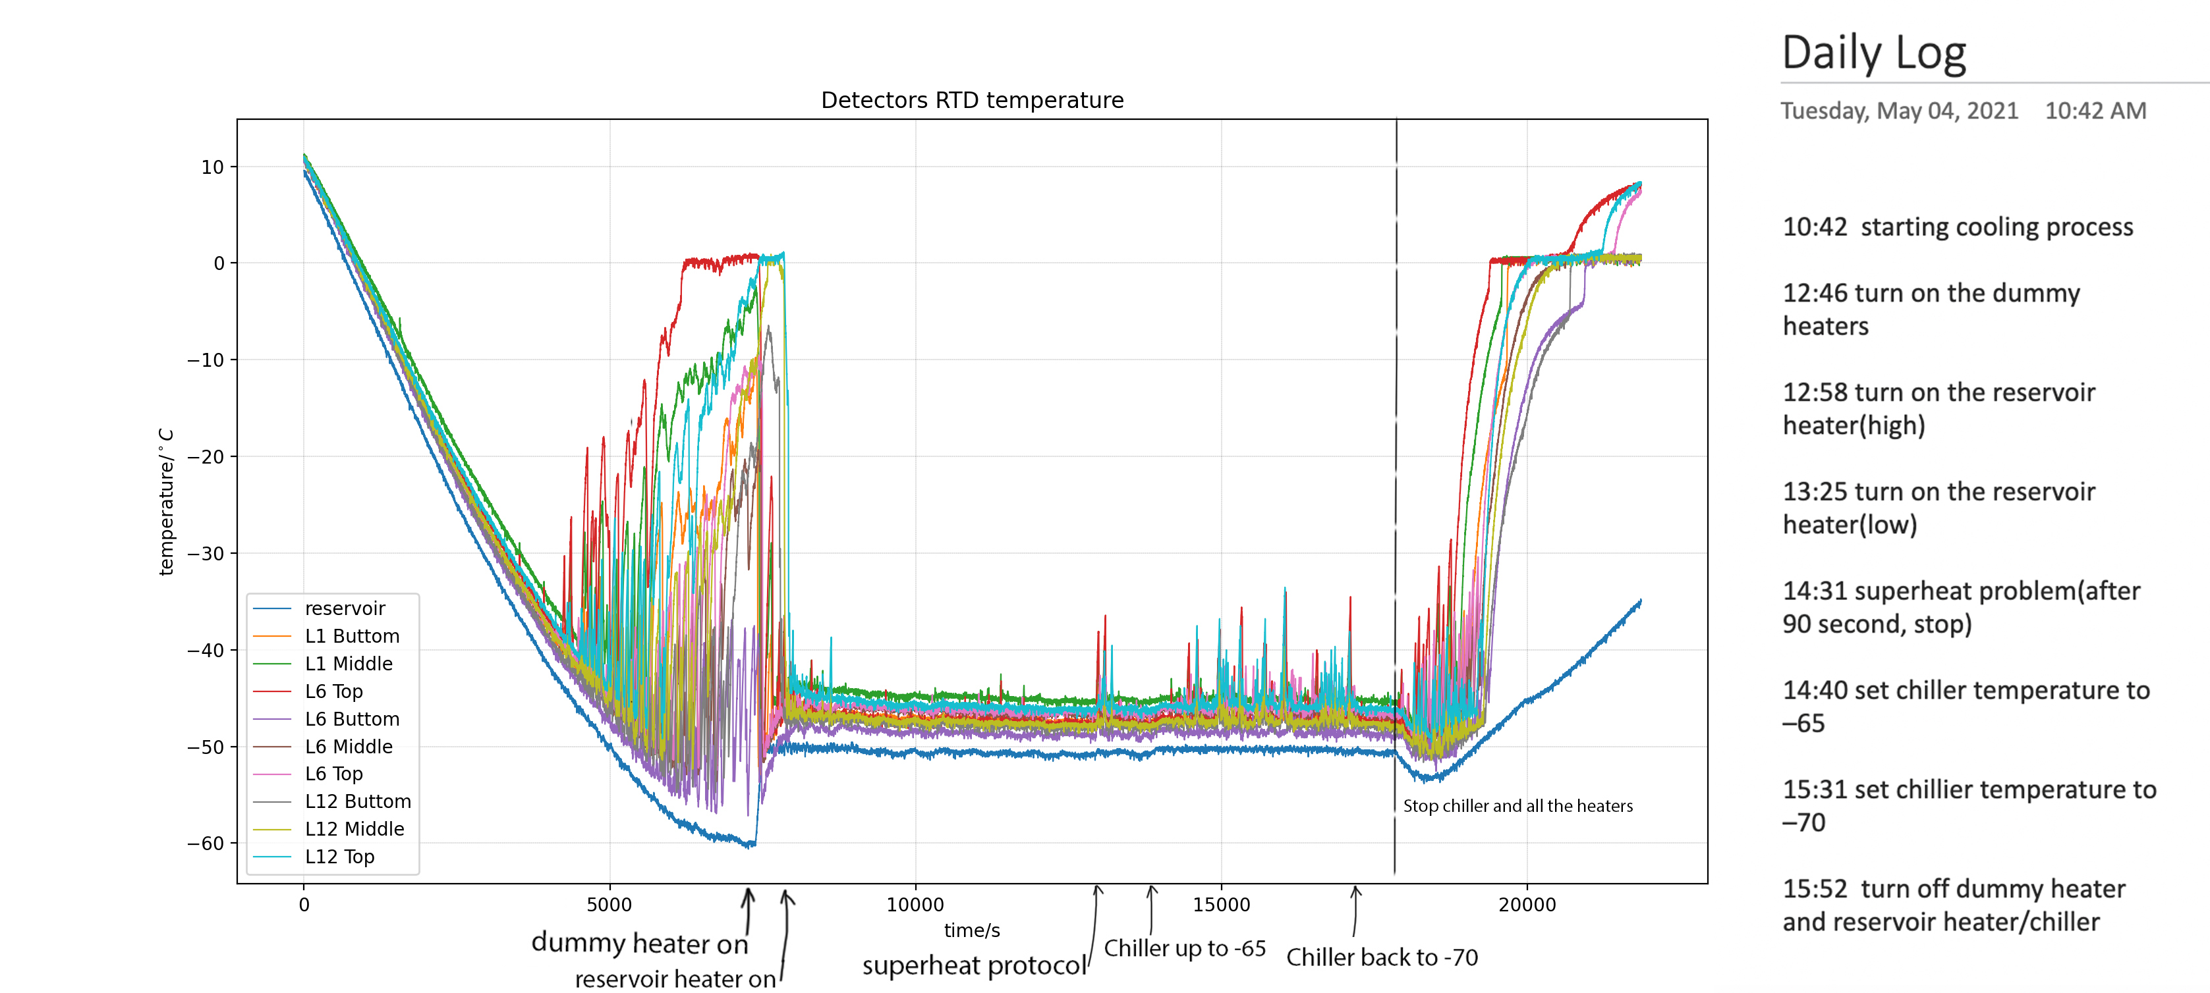
Detector temperature
After turn on dummy heaters and reservoir heater[-50.5, -50], temperature for each detector position drop dramatically, since the OHP circulation begin and heat will start transfer. The fluctuation for the equilibrium is about 1 degree C(see next slide).

Slide 5
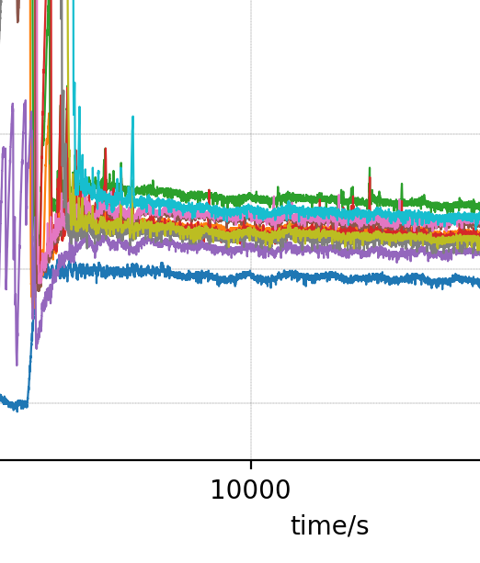
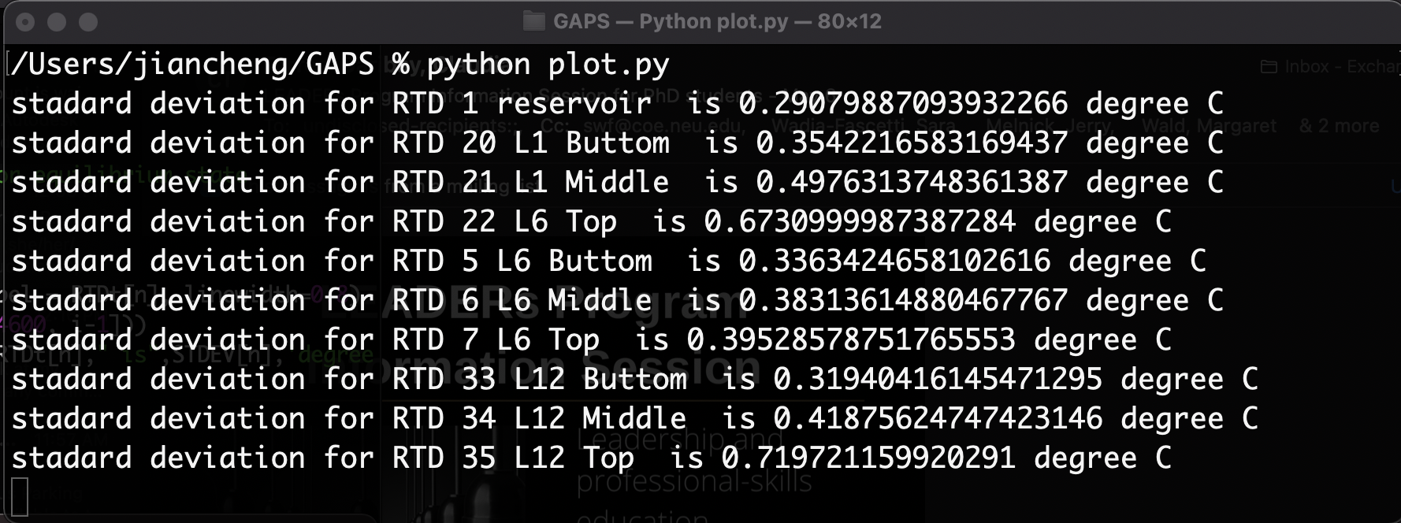
Stable state fluctuation

Slide 6
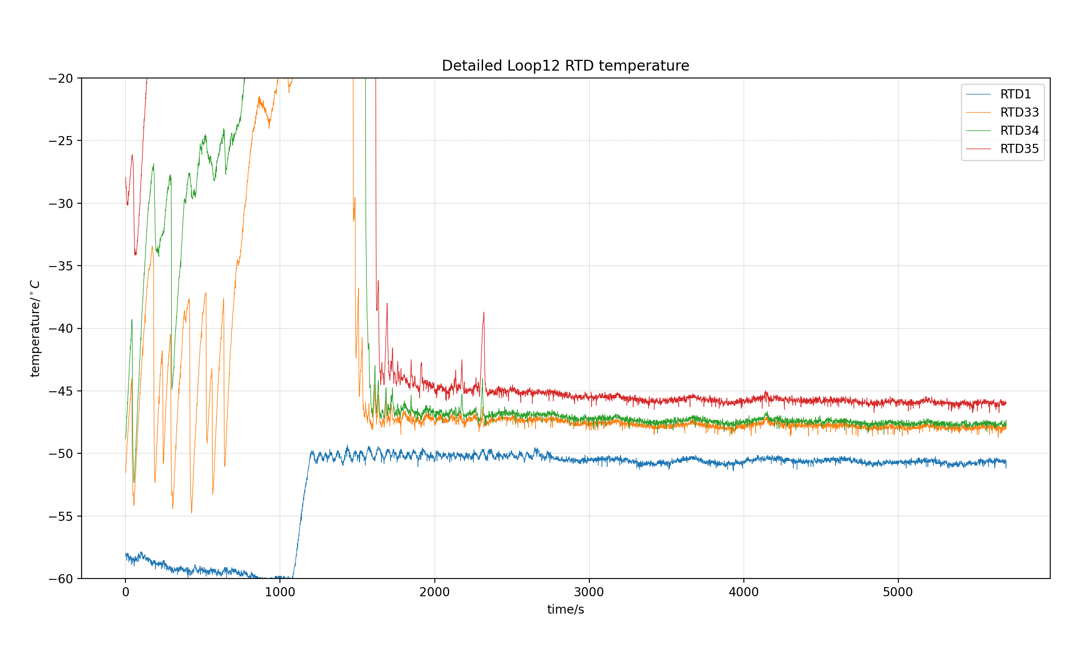
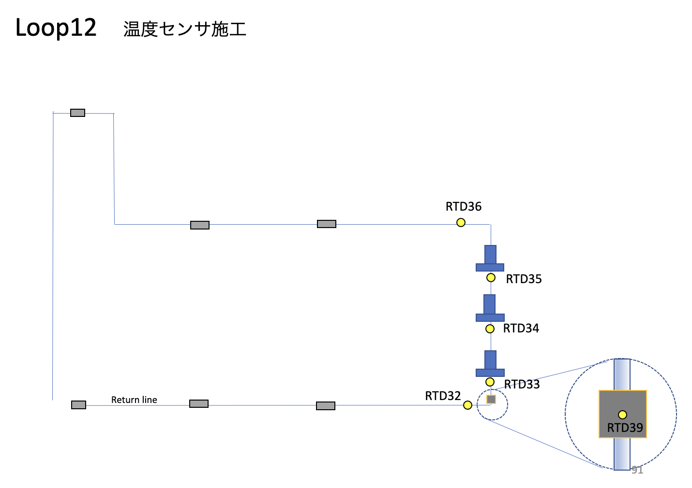
Detectors for each loop
Loop figure From JAXA

Slide 7
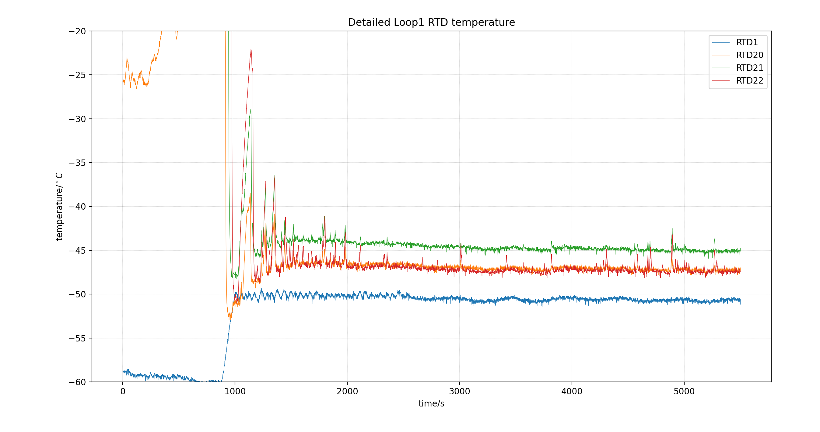
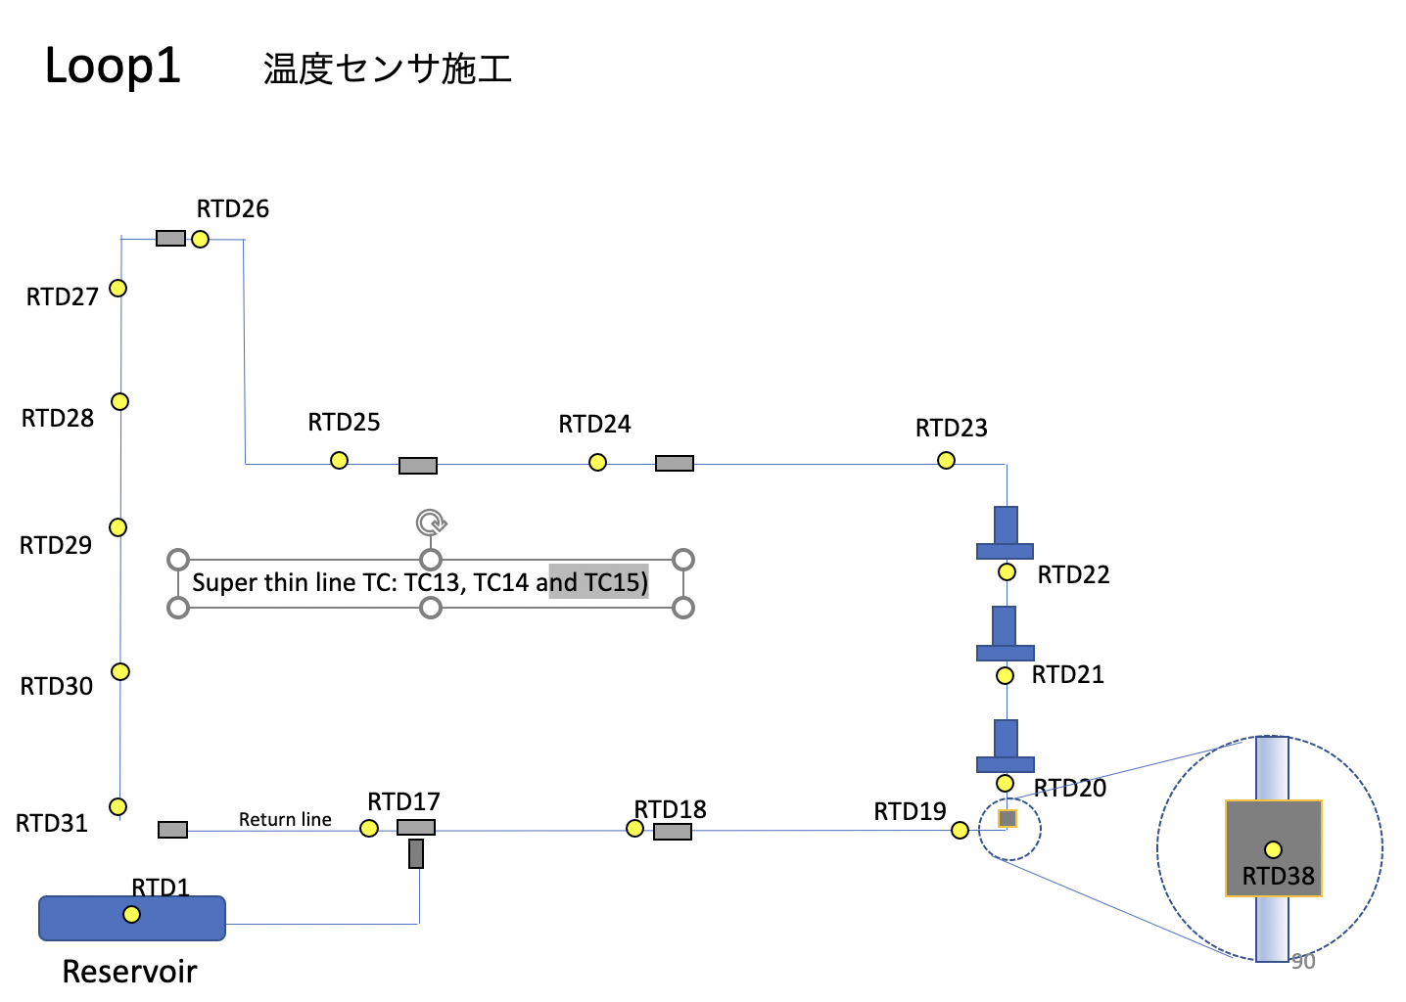
Detectors for each loop
Loop figure From JAXA

Slide 8
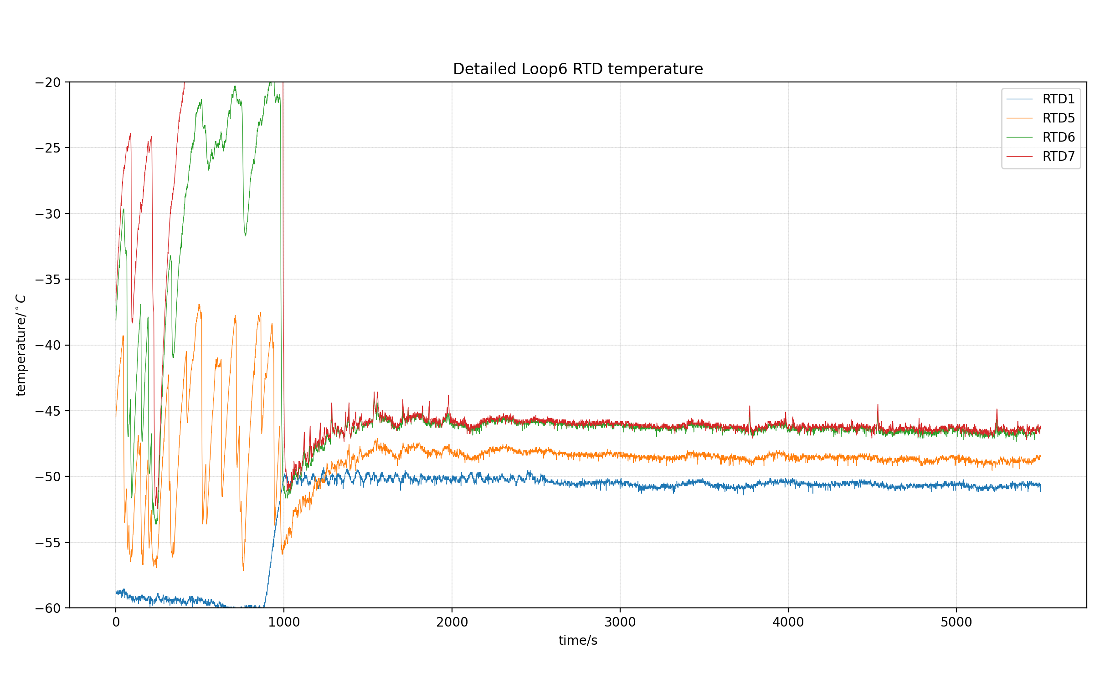
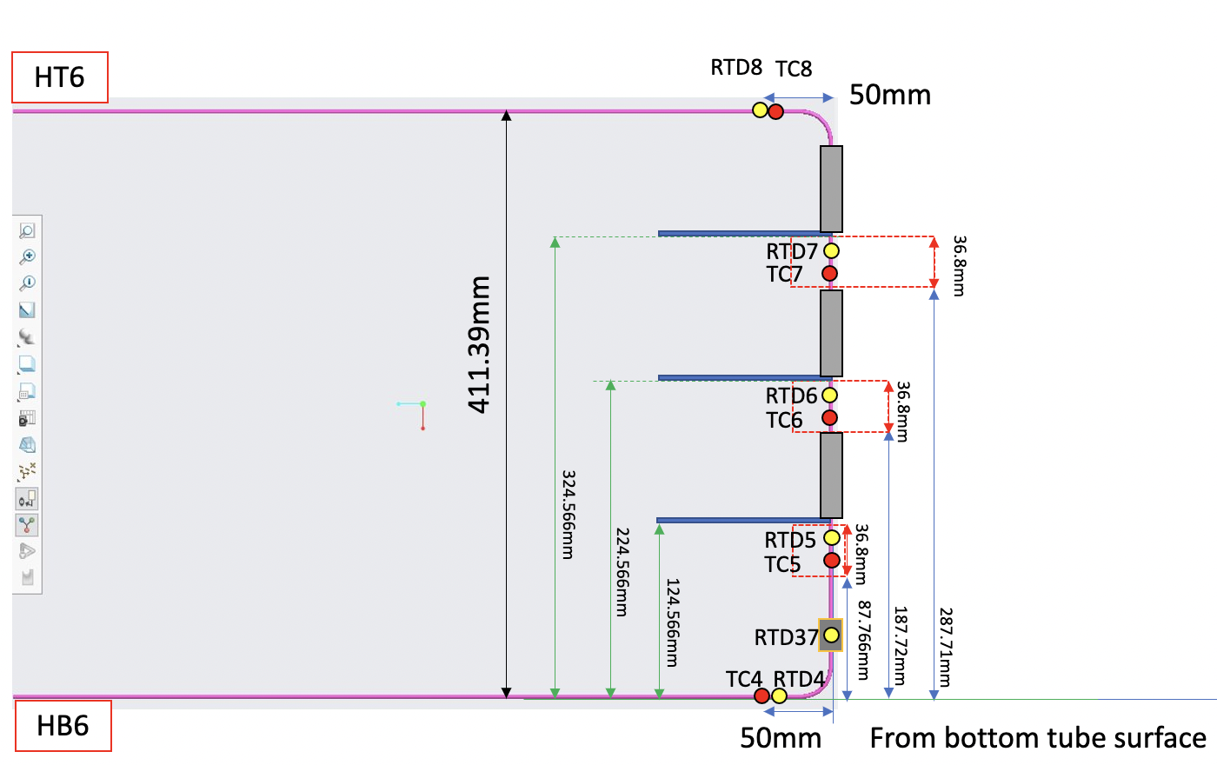
Detectors for each loop
Loop figure From JAXA

Slide 9
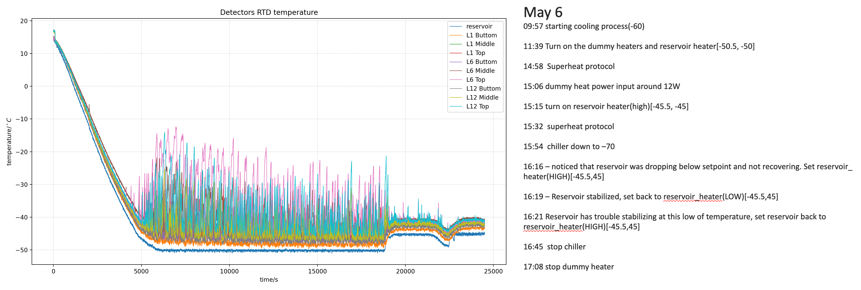
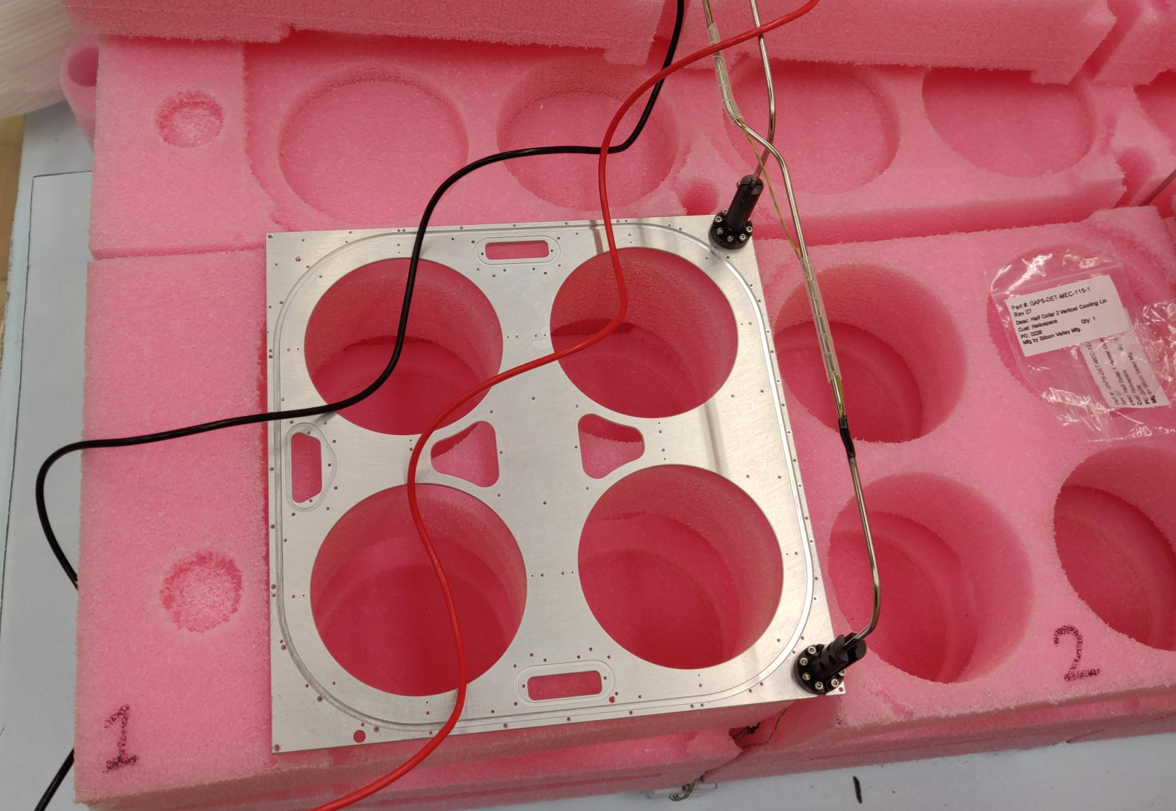
Will do a frame cooling test in next week to check whether the temperature will hold our requirement
For the pink small insulator, might change the insulation performance around detector region, will try to eliminate that error in next cooling test

Slide 10
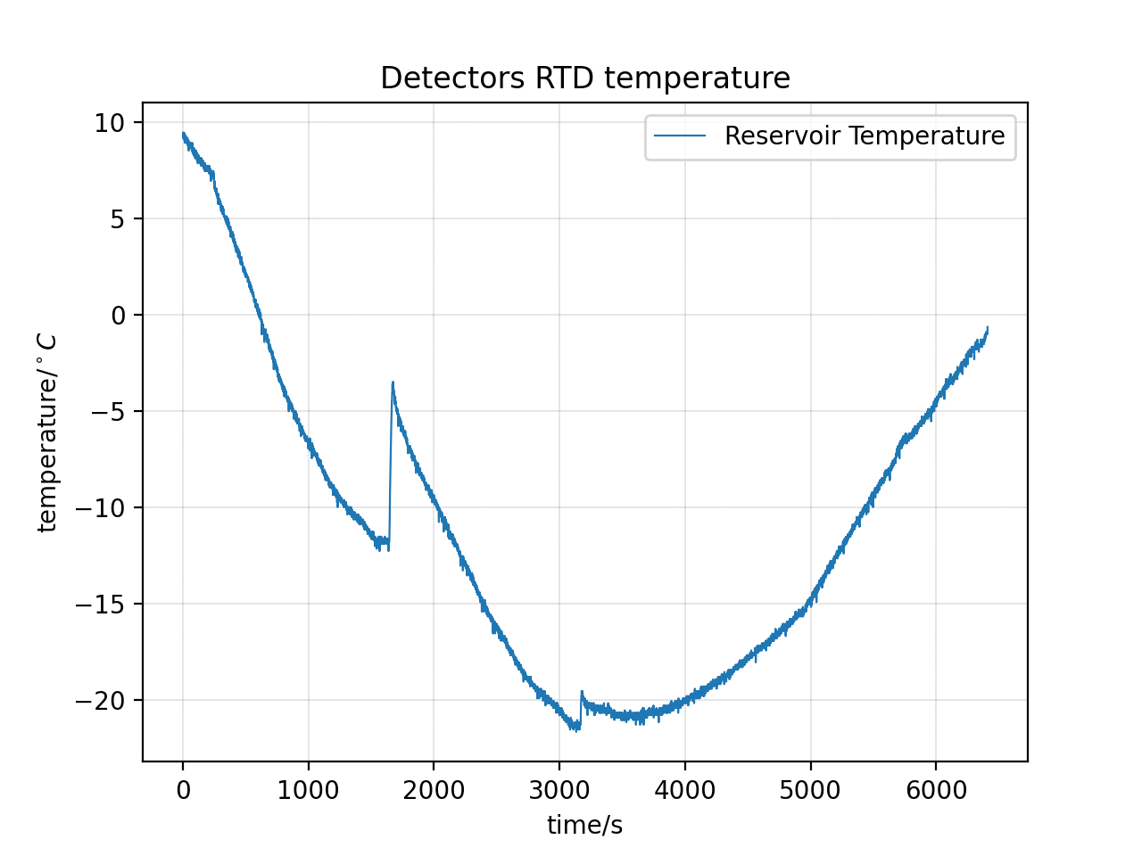
Leak check
04/29 1923g
05/07(8 days later)
We use chiller to cool reservoir down to collect as much gas/liquid as possible in OHP, and we monitored the reservoir temperature

Slide 11
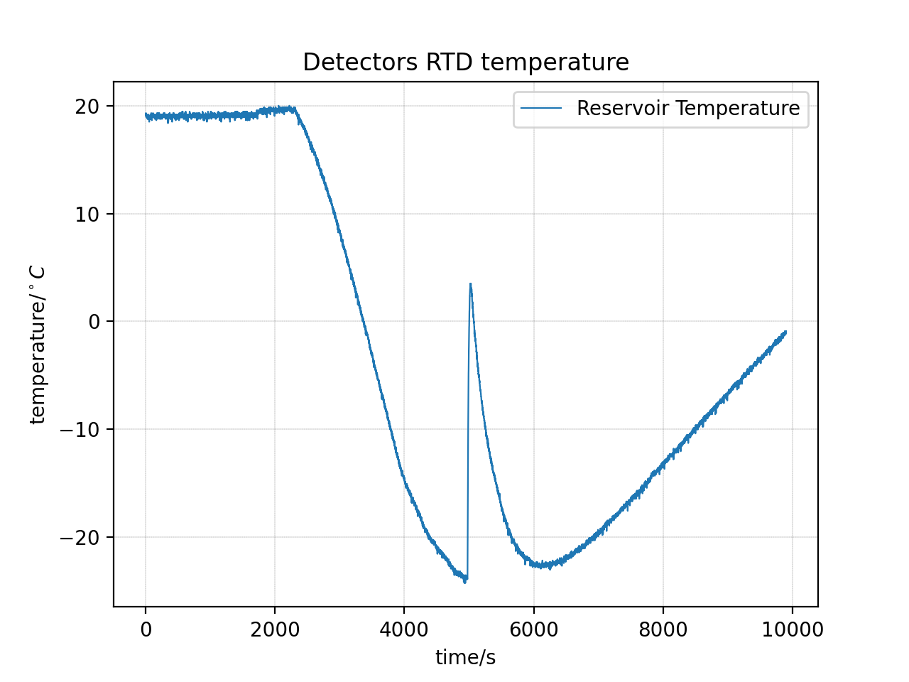
Leak Check(05/10, after 3 days)

Slide 12
Future plans and questions
Performing frame test and monitor the temperature, see whether it could maintain -40 degree C
Performing detector module test
Is it possible to use hot melt glue or gel?

Slide 13
Thank you

